Slide 1

SEToolkit
The Social-Engineer Toolkit (SET) is an open-source, Python-driven penetration testing framework designed to simulate and evaluate social engineering attacks.

Slide 2

FUNCTIONALITY
Phishing Attack
What It Does
Allows users to craft convincing emails and simulate mass mailer attacks to test employee susceptibility.

Slide 3

Website Attack
Credential Harvester
Clones legitimate websites (e.g., Twitter or Gmail) to capture user credentials.
Site Cloner
Creates malicious clones of real websites for deceptive social engineering scenarios.

Slide 4

Creates payloads embedded in files (like PDFs or Office documents) or USB drives that execute when opened or inserted.
Infectious Media Generator

Slide 5
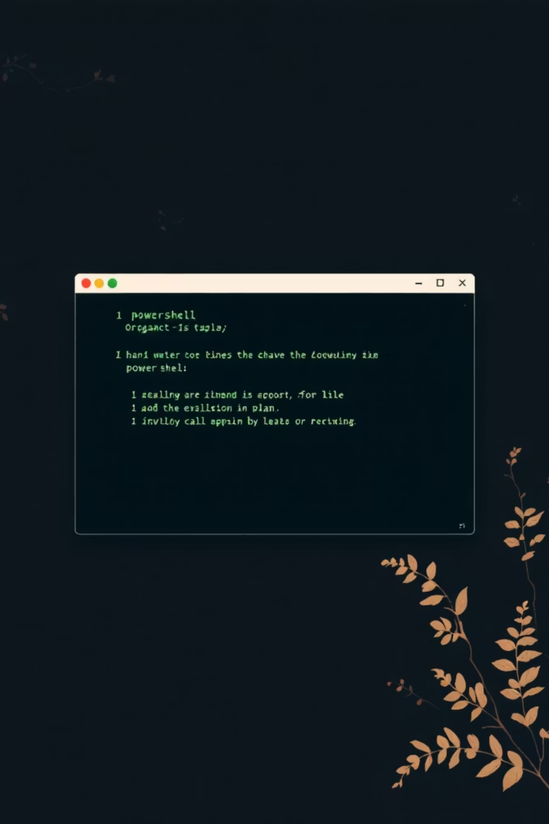


PowerShell Attack Vectors
Advanced Exploitation
Leverages PowerShell for advanced exploitation tasks.
Post-Exploitation
Leverages PowerShell for post-exploitation tasks.

Slide 6




Integration with Metasploit
Seamless Integration
Payloads
Seamlessly integrates with the Metasploit Framework for a powerful combined toolkit.
Provides payloads to deliver and execute on target systems.
Encryption
Listeners
Encryption for bypassing antivirus detection on compromised systems.
Listeners to handle compromised systems after exploitation.

